Slide 1
Indoor Plant Gardening: Growing Houseplants
Prepared by:
Etobicoke Master Gardeners
Etobicoke Master Gardeners www.etobicokemastergardeners.ca
Notes:
Welcome to the presentation on getting started with indoor plant gardening, growing houseplants can be just as rewarding as outdoor gardening. Plants in the natural garden rely on nature to meet their needs. Houseplants, on the other hand, rely on the gardener to meet all of their growing requirements. This introductory demonstration will walk you through the basics. Learn how to create your own indoor garden oasis by selecting indoor plants, learn about benefits of indoor plants, how to care and grow them successfully, some of the challenges of indoor gardening, and meet some of common and more unique and tropical indoor plants for your home. A draw will be held for some plant materials at the end of the demo.
To gain an understanding of the attendee experience, ask the participants to raise their hands if ,
1) they have tried and successfully grown indoor plants
2) They have tried but were unsuccessful
3) They delegated the task to someone else

Slide 2
Master Gardeners of Ontario
Notes:
Master Gardeners of Ontario is a volunteer organization comprised of individuals who are certified horticultural experts providing in depth sustainable gardening information to the general public.
Established in 1985, Master Gardeners of Ontario Inc. (MGOI) is an independent non-profit organization, run by volunteers, dedicated to providing accurate and relevant horticultural information to the public
Members presenting today are from Etobicoke Master Gardeners group, formed in January 2005
EMG comprises of 30 active members, and we welcome inquiries from enthusiastic and interested individuals wishing to learn more about MGs
Please visit our website to learn more, or if you are interested in becoming a Master Gardeners speak to any of our members after the session
These sessions are a joint effort by EMG & Humber Arboretum.

Slide 3
Agenda
Introduction
Esthetics of Indoor Plants
Growing conditions and indoor plant care
How to Choose the Right Plant
Challenges of Indoor Gardening
Indoor Plants
Wrap Up

Slide 4
Why grow plants indoors
Offers the pleasure and health benefits of gardening to those who don’t have outdoor space
Offers the option of growing tropical plants which are not suitable to our climate year round
Herbs can be grown to use in cooking year round
Planters can be used to complement and enhance our interior decor
Notes:
It’s known that peoples’ health suffers if they’re consistently deprived of contact with nature, and so for those without access to an outdoor garden indoor plants offer a chance to garden
Many beautiful tropical plants cannot be grown in our climate outdoors year round. These include citrus plants, gardenia, orchids and palms.
Having a small selection of herbs available to snip off as needed for cooking is much more economical than buying a large bunch of something you don’t need a lot of. There are many compact herb and vegetable planters now available.
When decorating your house or apartment, plants can be used as part of the décor, creating accent points

Slide 5
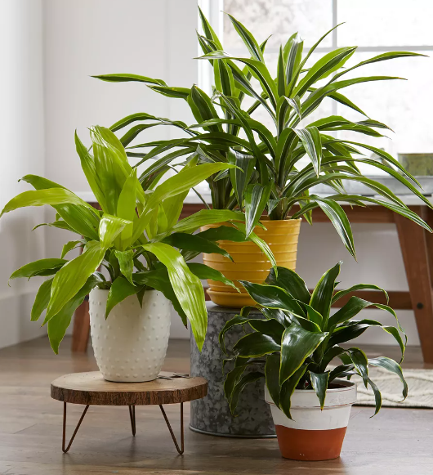
Esthetics of Indoor Plants

Slide 6
Aesthetics of Indoor Plants
A wide variety of shapes and sizes
Many have striking and colourful blooms
Offers many ways to display them
Keep us in touch with nature

Slide 7
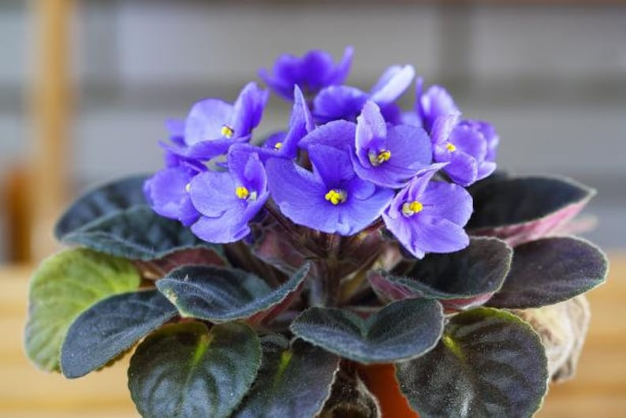
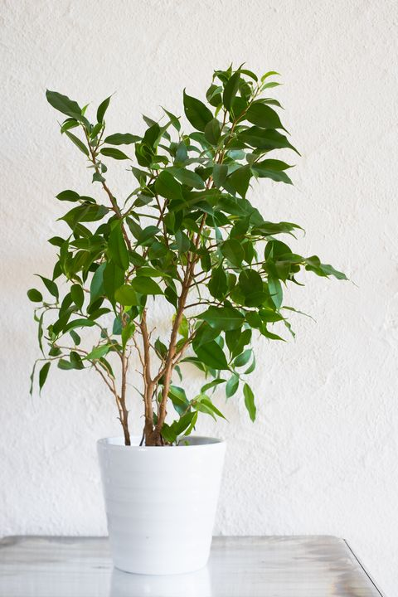
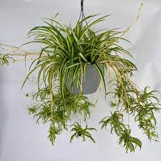
Sizes and Shapes
Small and compact
Tall and imposing
Suitable for hanging
Notes:
There is a large variety of small and compact indoor plants appropriate for small living spaces.
African violets come in various shades.
A lot of succulents and cacti are small and slow-growing.
Bonsai is another option for small spaces
Rubber trees, parlour palms and ficus benjamina are examples of indoor plants which will grow tall and act as a focal point with the right space and light
Spider plants, ferns and philodendron are examples of good trailing plants to have in hanging pots
We’ll cover some of these plants in more detail later on

Slide 8
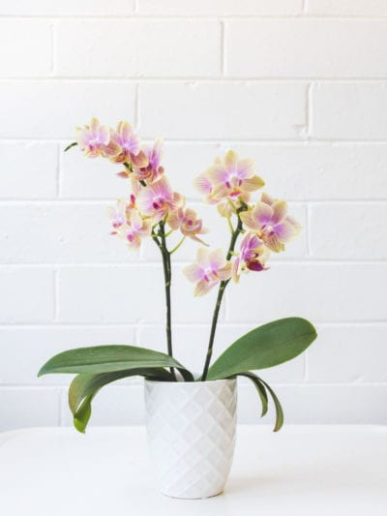
Beautiful Blooms
Orchids
African violets
Anthuriums
Cyclamen
Notes:
If you’re looking for blooms, rather than just greenery, orchids, African violets and azalea are all examples of indoor plants with beautiful blooms in a wide variety of colours
Of course you can also plant spring bulbs in pots indoors to brighten up those winter days –crocus, daffodils or hyacinths are particularly popular

Slide 9
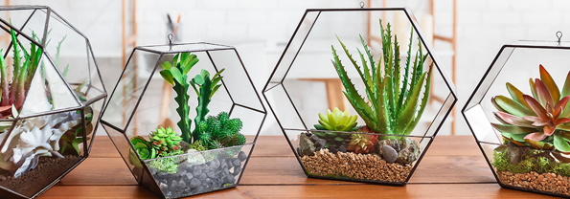
Ways to display plants
Depending upon the size and shape of your space:
Window displays
Accent plant and floor arrangement
Staged displays
Terrarium
Notes:
Indoor spaces will vary immensely in terms of room size, ceiling height, window size and what kind of light comes in.
These conditions will all determine what you can grow and where.
Trays can be placed on window sills filled with gravel for drainage and then pots placed on top. Or hooks can be drilled into the window frame and pots placed in macramé or other types of hangers to catch the light.
Large plants such as ficus, citrus and palms can be placed in the corners of large rooms as accent pieces. Light conditions will need to be appropriate for the plants, although the benefit of potted plants is that they can be moved around.
Staged displays on frames can also be very effective for small and medium sized pots.
If space is very limited, a terrarium is an excellent way of creating an accent piece. This is a garden enclosed in glass, and can be any size from a brandy snifter to a fish aquarium, but it must have a tight-fitting lid. Ferns, mosses and lichen are particularly good in a terrarium.

Slide 10
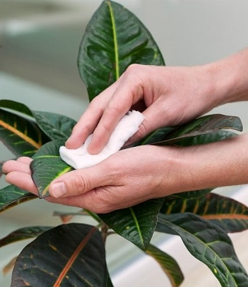
Growing conditions and Indoor Plant Care
balconygardenweb.com

Slide 11
Growing Conditions Indoor Plant Care
Temperature
Give them the WARMTH they need
Food
Give them the FOOD they need
Grooming
Give them the GROOMING they need
Light
Give them the LIGHT they need
Water
Give them the WATER they need
Humidity
Give them the HUMIDITY they need
Space
Give them the SPACE they need
Notes:
Plants growing in the garden rely to a large extent on the natural elements for their needs
House plants depend entirely on you to provide them with their essential requirements
Earlier in the session under Growing Conditions we discussed Light, Water, Humidity, Space, and Warmth (or temperature)
To ensure your complete plant care, it is important not to forget about Food, and

Slide 12
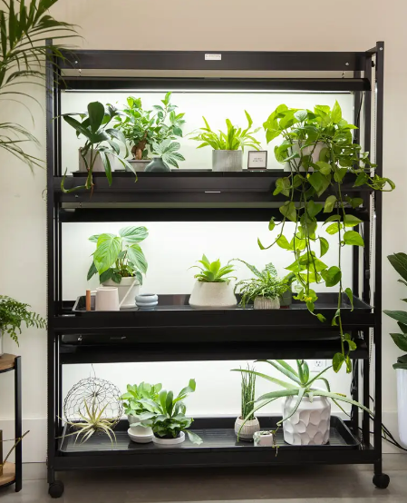
Light
High, Medium, and Low
Direct , Indirect
www.gardeners.com
Notes:
The best recipe for success is to match the growing conditions that you can provide with those needed by the house plant. All plants have slightly differing needs.
LIGHT
What is the amount and intensity of the light coming into your house?
All plants need light to grow but different houseplants require different amounts of light.
Look around your house to see the available spots for houseplants. Plants that need:
high light do well in front of southern-facing windows;
medium-light do well in east-facing windows or 2 to 3 feet away from high-light windows; and
low-light can tolerate north-facing windows and normal indoor lighting in most areas of your home.
Direct light: there are houseplants that require hours of direct light daily with the sun shining right on them
Be aware of trees and buildings outside.
An obstructed southern window may get less light than a northern one.
Keep in mind the night-time temperatures make window sills cooler, especially in winter.
Turn plants occasionally so the plant does not grow lopsided

Slide 13
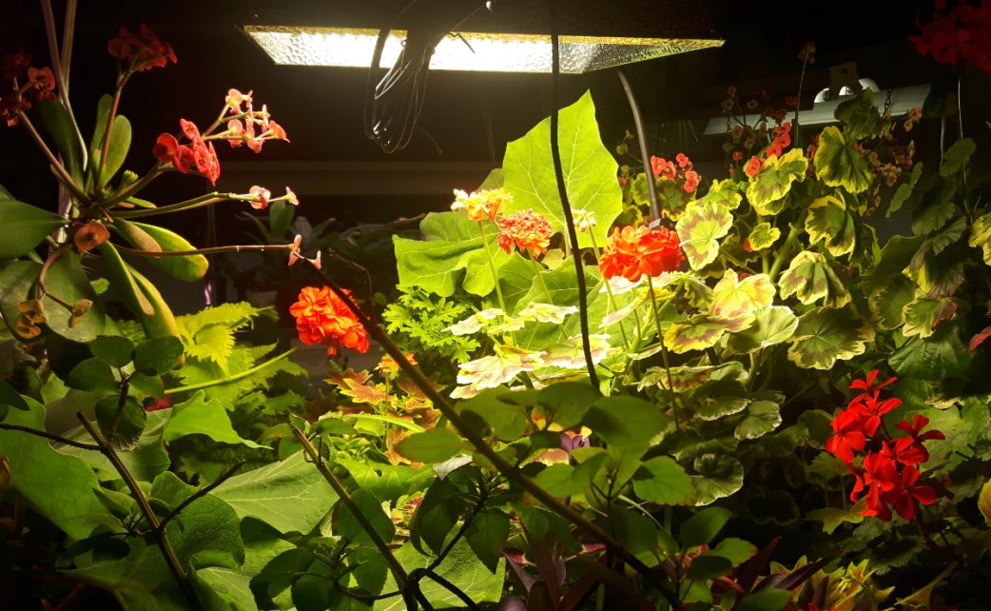
Growing Under Lights
Things to remember
Light – 12 hours/day
LED lights are best
Water
not too much!
Fertilizer
just a little
Air movement
use a fan
Notes:
Light = 12 hours per day.
LEDs are best but most plants are fine under fluorescent lights.
Plants must be kept very close (1 to 2 inches – don’t worry about heat – the bulbs are not hot) to fluoro lights to get the maximum amount of light and avoid getting leggy
If plants do get leggy pinch out extra growth to keep plants compact.
LED lights are powerful, so plants can be kept 18” below them.
They are pricey (Mars Hydro TS 1000 light in pic = $200+tax on Amazon…this covers a 4’ x 4’ area) but the dent in the electric bill is noticeable – buy one that is dimmable.

Slide 14
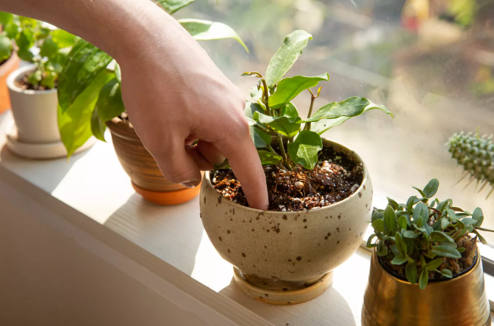
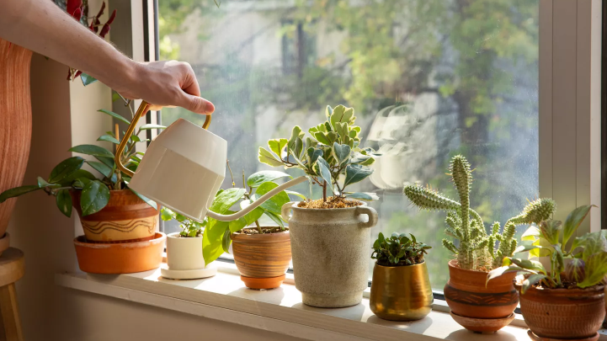
Water
Over
Under
www.gardeners.com
BHG / PHOEBE CHEONG
Notes:
Water
Do not focus on how often to water, but rather focus on how much.
Using the finger test, pushing your finger 1-2 cms into the soil,
If the soil is moist to the touch, the plant is not yet in need of water
If the soil is dry, give the plant a good watering
Water houseplants with lukewarm water whenever the top 1 to 2 inches of your potting soil mix are dry.
Some plants prefer to be watered directly on top of the soil and others do best with watering from the bottom. Research your selected houseplant to know which method it prefers and the ideal amount of water. How much water a plant will need depends on their country of origin and the environment they evolved in.
Some plants do not mind drying out if one is forgetful; others require specific watering regimes and attention.
Watering: it is best to keep plants under watered that over-watered

Slide 15
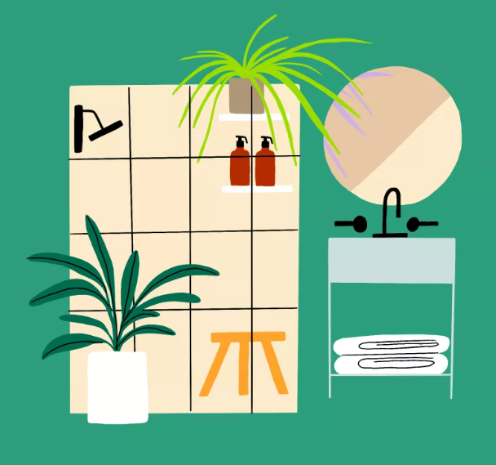
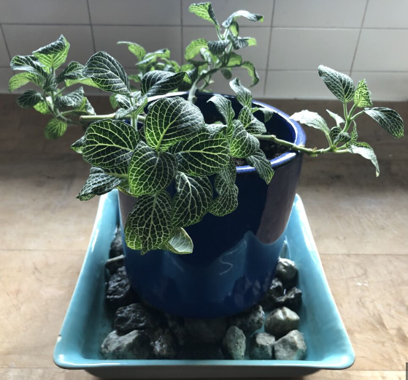
Humidity
www.latimes.com
www.latimes.com
www.latimes.com
Notes:
Humidity
The majority of houseplants appreciate humidity levels of 50-70 percent; generally higher than in the average home and particularly in the winter.
Group plants together to create a micro-climate that supports an elevation humidity level
Misting leaves with water if the plant will tolerate this– very lightly
Cool-vapour humidifiers
Set some water-filled dishes near the plants
Set the plant on a dish filled with pebbles and keep filled with water

Slide 16
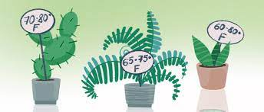
Temperature
blossomplant.com
Notes:
Temperature
The temperature that you prefer to keep your house at in the summer and winter months will affect the growth of the house plant.
Select the plant that will thrive in the temperatures you keep your house.

Slide 17
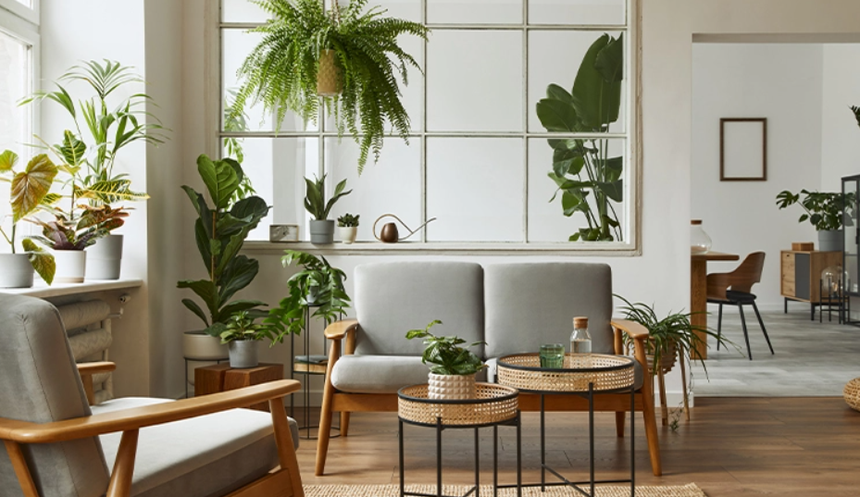
Space
Notes:
Space
Take time to consider size of the plant for the space in which you will put the plant.
The larger plants may only suit a few places in your house and do not move very easily if adjustments are needed.
Smaller plants can easily be moved should they need more suitable spot to match their required growing conditions.
Hanging plants need space away from traffic as they enjoy hanging undisturbed.

Slide 18
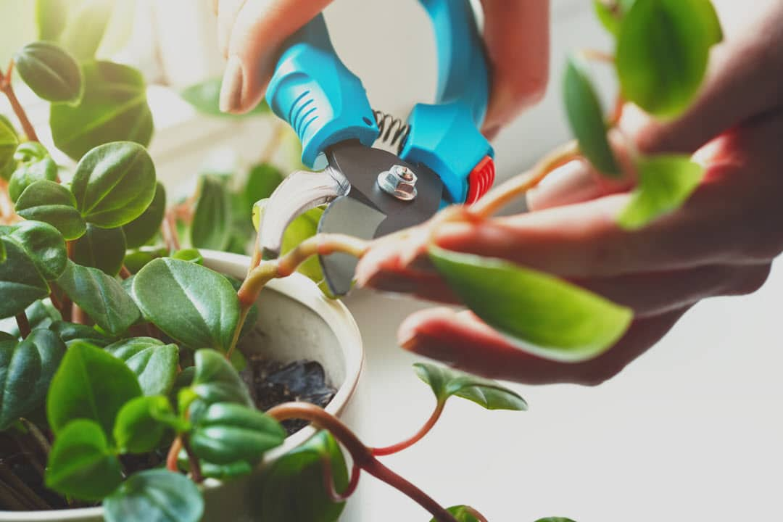
Grooming Your Indoor Plants
Cleaning
Polishing
Training
Pruning
https://www.finegardening.com/project-guides/gardening-basics/the-science-behind-plant-division
www.bing.com
Notes:
Cleaning
Dust is an any of house plants, it:
Blocks the leaf pores to the plant does not breath properly
Forms a light-blocking screen preventing the full effect of daylight
May contain plant-damaging chemicals
Spoils the appearance of the foliage
It is necessary to remove dust when it becomes noticeable on the foliage
Small plants can be immersed in water, or you can sponge the leaves with clean water
Wash plants early in the day so they can dry before night-fall
You should dust the plant before washing, preventing the dust to ‘mud up’
When washing leaves support them with your hand
Polishing
As foliage ages it may become dull, the glossy sheen o the new leaf is lost
Different plant-polishing materials are available, ensure you a product safe for plants
Do not polish young leaves, and do not press down on the leaf surface
Read the label, and check the lists for plants which should not be polished
Even better, clean your plants, and stay with the natural look
Training
Training is the support of stems to ensure maximum display
This is most common for climbing plants, and non climbers with weak stems, heavy flower-heads, and brittle stems
Train new growth before it becomes long enough to be untidy or difficult to bend
Pruning
Three techniques of pruning include;
Pinching out (stopping) is the removal of the growing point at the stem
Cutting back (pruning) is more extensive cutting out of excessive growth
Trimming is the removal of dead leaves, damaged parts and faded flowers
Many plants get out of hand and deteriorate if not regularly pruned and timed
Always cut dead and diseased stems, crowded stems and all-green shoots on variegated plants
Cut back over-long branches and old leafless stems
Dead-heading will prolong flowering of many species

Slide 19
Feeding your indoor plants
N – P – K
Nitrogen Phosphorous Potassium
Notes:
All plants, indoors and out, need an adequate supply of nitrogen, phosphorous, and potassium
Nutrients:
N = Nitrogen
stimulates lush green growth of leaves and new shoots, promotes dark green colour
P = Phosphorus
promotes development of strong healthy root system and setting of flower buds
K = Potassium
aids in the overall strength of stems and roots and resistance to disease
There are also several micronutrients, including essential elements such as Iron, Manganese, Zin, Chlorine, Sodium, etc. each providing various functions for plants
In the garden you apply fertilizers to the soil, and in the absence, plant can draw on the soil’s supply of nutrients
It is different for indoor plants as the soil in the pot contains a limited amount of food and is continually depleted by the roots of the plan and by leaching through the drainage holes
Once the nutrient supply is exhausted, for potting composts this would be approximately 2 months before nutrients are depleted, regular feeding is needed when the plant is actively growing is required
House plant foods are normally compound fertilizers containing NPK
They come in different forms such as insoluble powders and granular, pills and sticks, and liquids
Use a balanced fertilizer. Specialist fertilizers not required
Soluble in water is easiest to use
Recommend less than manufacturer recommends. 1/2 to 1/3 of amount to prevent build up of salts in the soil – Water ‘weakly’ not weekly
Only when in growth phase. New buds or leaves are forming.
Plants have the ability to tell you what is wrong, for example:
Light green to yellow leaves, growth stunted = nitrogen deficiency
Red or purple leaves = phosphorous deficiency
Yellow leaves , veins remain green = iron deficiency
Dark green leaves, excessive growth = excessive nitrogen

Slide 20
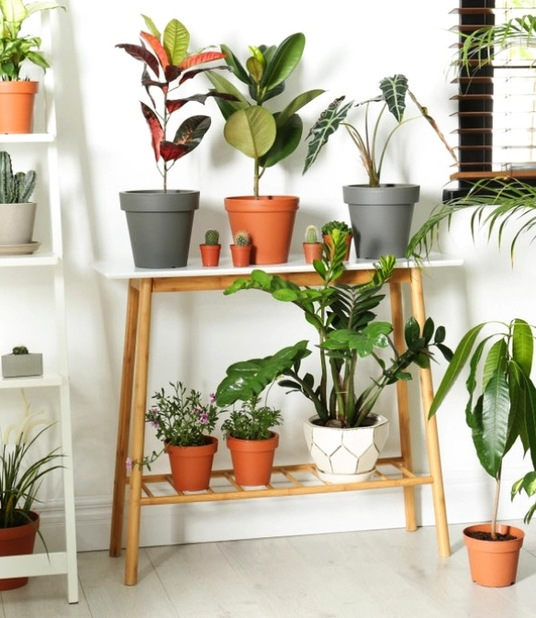
How to choose the right indoor plants
anthemionflowers.com

Slide 21
How to choose the right plant
Ask yourself the following questions:
Do you want the plant to be on display all year round
How much time and skill do you have?
How much do you want to spend?
What size and shape plant do you want?
What will the growing conditions be like?
Notes:
There are many types of plants now available, look around to get ideas to see which plants interest you and flourish
If you want to buy yourself a house plant, ask yourself five questions and the answers will give you a short list of plants
Then select the plant from the list that interests you
Do you want the plant to be on display all year round?
Most foliage plants keep their display
Flowering plants are more complex, and may have limited display
How much time and skill do you have?
Some plants are extremely hardy, and do not require much care (such as Succulents, Coleus)
Others are ‘delicate’ and may be a challenge to care (such as Gardenia)
How much do you want to spend?
Consider the growth speed of the plant, and difficultly in growing or propagation
What size and shape plant do you want?
Think about the size and shape , and how much space you have
What will the growing conditions be like?
How much light will be available and will the location be heated

Slide 22
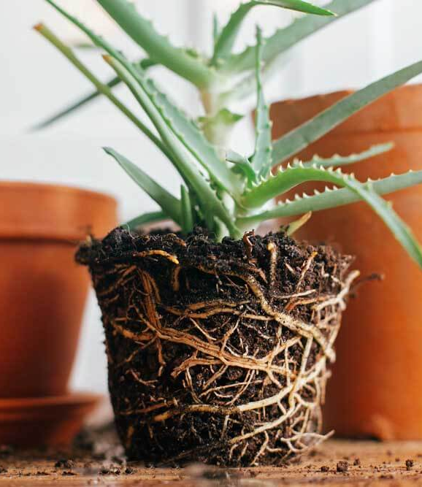
Challenges of Indoor Gardening
fafard.com

Slide 23
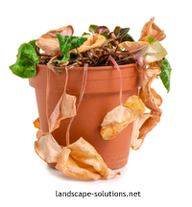
Plant collapse
The seven most common fatal factors are:
Soil dryness
Overwatering
Cold nights
Strong sunshine
Hot, dry air
Draughts
No light
Notes:
There are many possible reasons which can account for the death of an indoor plant
It is important to be aware of your growing conditions
Over and/or underwatering, poor lighting conditions, pot bound or insufficient space, extreme temperatures impacts the success of your indoor plants
We will discuss growing conditions later in the session
The seven most common fatal factors are:
Soil dryness
Overwatering
Cold Nights
Strong Sunshine
Hot Dry Air
Draughts
No Light

Slide 24
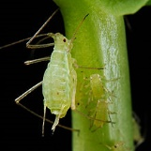
Pests
Less common than outdoors
Can cause serious damage
Treat once identified
Some common pests include;
Aphids
Spider mites
Fungus gnats
Notes:
Pest attacks are less common indoors than in the garden
If thy occur and are allowed to get out of control, can cause serious damage
Apply the appropriate remedy, or apply cultural practices once identified
On this slide we cover a couple of common pests, we will cover more specific pests as we discuss indoor plants later in the session
Aphids
Nearly invisible to the naked eye
Signs include tiny, sticky holes or yellow/misshapen leaves
To control combine equal parts of rubbing alcohol and water and apply to the plant
Spider mites
Can be detected by small dark specks
If a plant is infested quarantine your plant (we will discuss this later in more detail)
Spider mites love dry warmth, thus give your plant a tepid shower, and frequently spray the plan
Fungus gnats
Prevent the top of the soil from becoming moist through overwatering , which is what attracts the gnats

Slide 25
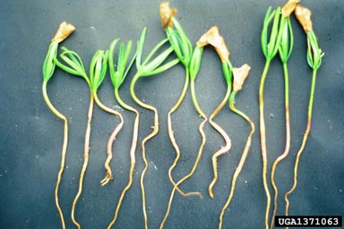
Disease
A sign of poor growing conditions
Take immediate action
cut out the affected area
use fungicide if recommended
correct the cultural practice
Some common disease include;
Damping off
Root Rot
Crown & Stem Rot
Notes:
The appearance of disease is normally a sign or poor growing conditions
Immediate action is key, cut out the affected area as it is identified, use fungicide if recommended, and correct the cultural practice
Some Common disease include;
Damping Off
The damping off fungi attack the root and stem bases of seedlings
Shrinking and rot occur at the ground level, and the plant topples over
Key to use sterilized tools, sow thinly, never overwater, improve air circulation
Root Rot
First sign is the yellowing and wilting of the leaves , followed by browning and collapse
The cause is a fungal decay of the roots due to waterlogging
Plant can be saved if the trouble is spotted early
Crown & Stem Rot
Part of the stem or crown turns soft and rotten
The fungus spreads rapidly and kills the plant
Throw the pot compost and plant away

Slide 26
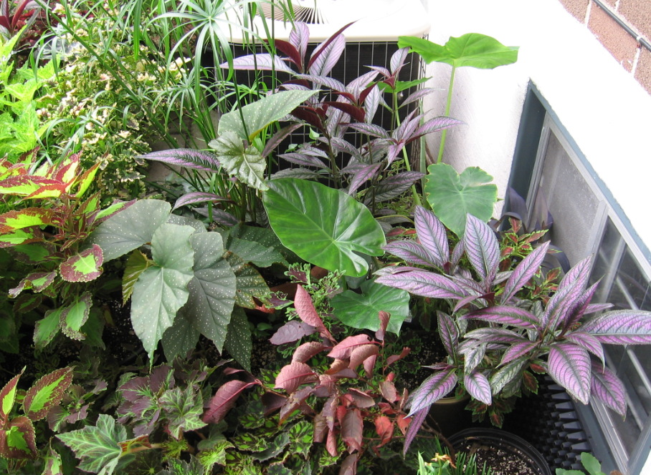
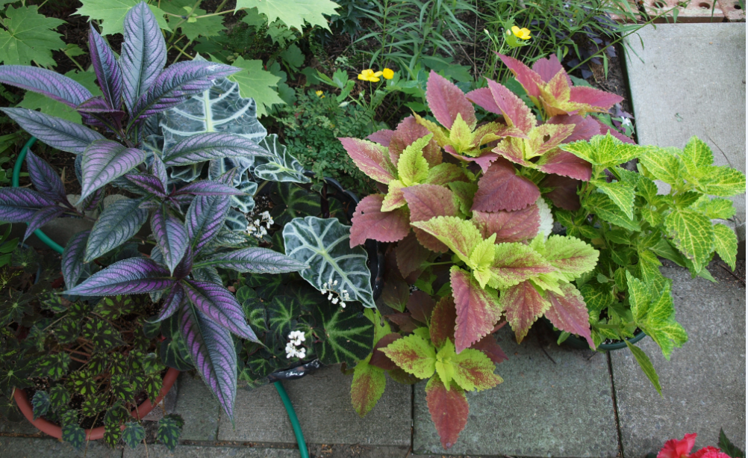
Bring plants in from the outdoors
Houseplants benefit from a summer vacation in a shady spot
When they are ready to come in apply a soil drench with insecticidal soap, and spray the leaves thoroughly
Quarantine the plants for a few weeks
Also apply the quarantine status to newly-bought plants
Notes:
Houseplants benefit from a summer vacation in a shady spot.
Take them out when it is well warmed up – early June.
Put them in a shady, sheltered spot (they are used to lower indoor light levels and no breeze).
Move the sun-lovers into the sun after a few weeks. If the plants still get sun-scorched don’t panic – just remove the scorched leaves – new ones will grow in (prime example = tender hibiscus).
When they are ready to come in Prune back the plant as much as possible. Also put into a smaller pot if possible). Remove older leaves from the stems.
Then apply a soil drench with insecticidal soap, and spray the leaves thoroughly (top and bottom). Insecticidal soap dissolves soft-bodied insects and eggs.
This all helps to reduce the potential for bringing enemies in.
Quarantine the plants in a separate room for a few weeks after you bring them in to observe for pests.
Jim remark – following the above routine I find that the bugs appear around early December.
Quarantine also applies to newly-bought plants. You may be bringing unwanted visitors back from the garden centre.
Pics – tender plants on a shady patio – Persian Shield, Elephant Ears, various begonias (cane and foliage), various Coleus, Umbrella Plant.

Slide 27
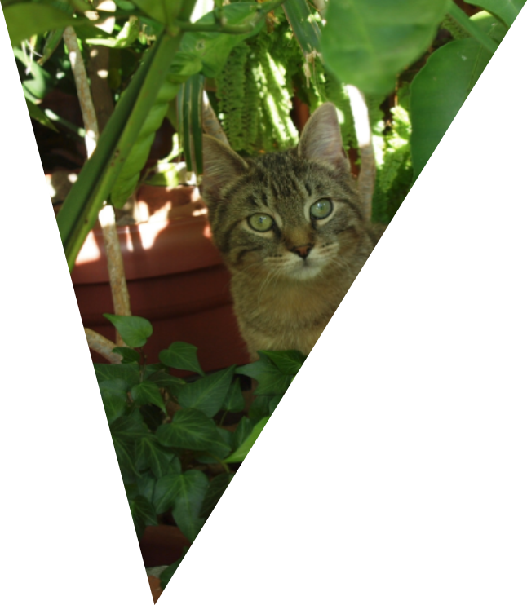
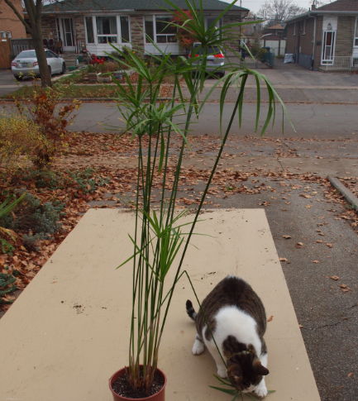
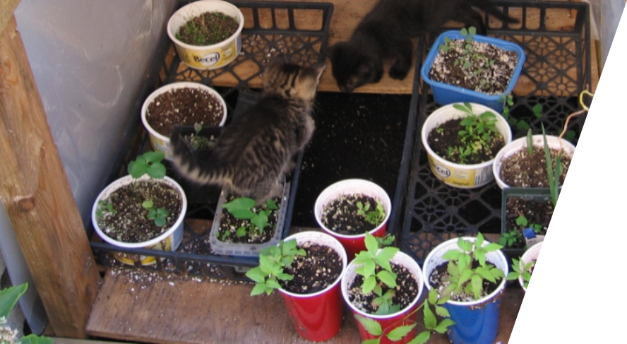
Predators
Keep plants out of reach of cats and dogs
Cats regard some leaves as a form of grass, which is often eaten.
Dogs may dig in larger pots
Notes:
he cat regards the leaves as a form of grass, which is eaten often to act as a purgative (helps to cough up furballs).
Umbrella plant (Cyperus alternifolius) being browsed by Felis catus
The umbrella leaves are rougher than grass and always cause the cat to be sick
The plant can be placed up high – but an enterprising cat will learn to break down the stems....so a closed room may be better
The plant is not otherwise toxic
For animals that dig in larger pots (and maybe pee in them), place objects on top of the potting medium to prevent access.
Decorative stones will work
Otherwise keep the plants in a room that is off-limits to the animals.

Slide 28
Indoor Plants

Slide 29
Indoor Plants
African Violets - Saintpaulia spp
Aloe Vera - Aloe baradensis
Herbs
Jade Plant - Crassula ovata
Money Plant - Pilea peperomioides
Monstera - Monstera deliciosa
Orchids (Anthuriums, and Bromeliads)
Parlour Palm - Chamaedorea elegans
Pothos - Epipremnum aureum
Peace Lily - Spathiphyllum wallisii
Rubber Plant - Ficus elastica
Snake Plant - Dracaena trifasciata
Spider Plant - Chlororphyium comosum
Succulents, Cacti

Slide 30
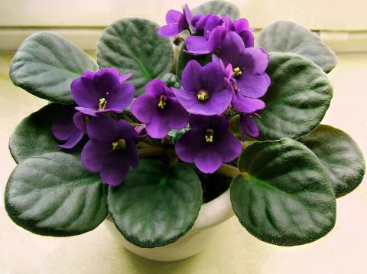
African Violets – Saintpaulia spp
hgtv
Notes:
Common & botanical name:
African Violets – used to be Saintpaulia spp, but seem to have been reclassified as Streptocarpus ionanthus.
Description:
African violets are native to tropical East Africa, which gives plenty of clues about their care. African violets will thrive in bright, warm and humid conditions
Size:
Small and compact.
Watering & Air Humidity:
- Keep soil moist with warm water. Do not allow water to contact the leaves of the plant to prevent damage. Water from below, or push the water spout into the soil when watering. However do not allow the plant to sit in water after its watering.
Light & Temperature:
African violets do well in bright, indirect light. They should be placed close to the window but not in direct sunlight If the leaves start getting light green, your plant is getting too much light, while thin and dark green leaves or a leggy plant indicate too little light. For maximum blooms, provide ten to 14 hours of bright but indirect light per day and an eight-hour rest period in darkness.
In winter when the light levels are lower, you may need to move your plant to a brighter spot. Lower winter light means less blooms.
African Violets prefer warm and humid conditions. Do not allow the temperature to fall below about 60 degrees Fahrenheit. Set the plant in a place where it will be protected from drafts, especially in winter.
Repotting:
Plant needs to be re-potted when the plant has outgrown its pot, ceased to flower, or develops multiple crowns before repotting
A well-drained potting mix is essential for African violets. Poor drainage can cause root rot, in which the plant becomes waterlogged and its leaves begin to fall. African violets need to be repotted. Wait until the plant has outgrown its pot. African violets perform best when their roots fit snugly in a pot, so select a new pot that is only slightly larger than the old one and not too deep as the plant has shallow roots. Remove about one-third of the old soil and replace it with new potting mix. Make sure that the crown of the plant is just above the soil line.
Pests & Disease:
Common pests include spider mites, mealy bugs, and cyclamen mites. Diseases include fungi such as botrytis blight, crown rot and root rot. Do not overwater and keep good air circulation around the plant and proper lighting
Propagation:
Leaf cuttings.
Pet Friendly: (i.e. poisonous)
- Non-toxic

Slide 31
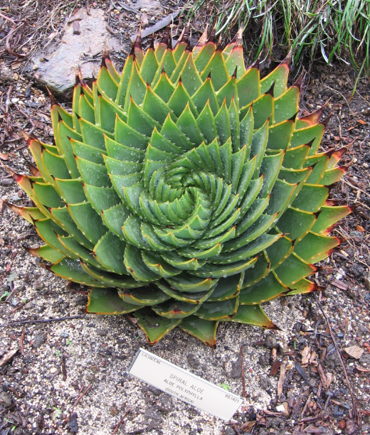
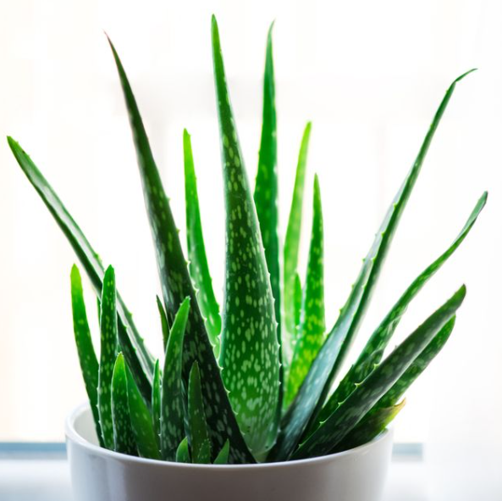
Aloe Vera - Aloe baradensis
www.goodhousekeeping.com
Notes:
Spiral Aloe (Aloe polyphylla) – Berkeley Botanical Garden
Common & botanical name:
- ALOE-VERA or BITTER ALOE or South African Aloe variegata "Partridge Breast"
Description:
- A succulent used for medicinal / decorative purposes, grown over 3,000 yrs. Origin Egypt.
Heals minor cuts, scalds, burns. Relieves effects of insect bites & poison ivy when prepared as a poultice.
Size:
- Develops leaves 1-2 ft. (.3-.6 cm) long
Watering & Air Humidity:
- Low water requirement (even less in the winter)
Light & Temperature:
- Full sun to 4 hours of sun each day. OR 12 hours of light under florescent light
Repotting:
- Soil: 1/2 Tropical Plant Soil or Horticulture Sand to each gallon (4.5) of mix, add 1 tbsp (15 ml) of ground horticultural limestone & bonemeal. Feed in March & Oct w/ 8-8-8-fert, Do not feed newly potted plants.
Pests & Disease:
- Pest free, easy to grow.
Propagation:
Offsets
removal of suckers, cuttings of young growth
Pests /Diseases: Mealy bugs & root mealy bugs both infest plant. Check leaves regularly. If plant sickly, scrape away top ½ of potting mix & inspect inverted plant to ensure no insects on roots. Repot in same pot.
Pet Friendly: (i.e. poisonous)
Toxic to dogs and cats.
Potentially toxic to humans (diarrhoea)

Slide 32
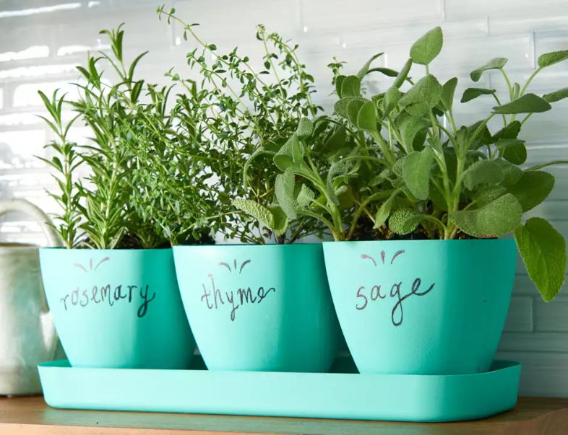
Herbs
www.eatingwell.com
Notes:
Common & botanical name:
-
Description:
Indoor herb gardens not only provide fresh, but also fill your home with fragrance and greenery
Most herbs can be grown indoors, but those that tend to really thrive inside include basil, chives, mint, oregano, parsley, rosemary and thyme
Harvest a few sprigs with shears or by pinching leaves off with your fingers
Regular cutbacks encourage new growth.
Avoid removing more than a quarter of the plant at a time, which will cause distress and could even kill the plant
Size:
- Varies by type
Watering & Air Humidity:
keep the soil consistently moist, but not waterlogged
Light & Temperature:
- Most herbs prefer a lot of sunlight, at least six hours of sun per day
Place plants as close as possible to your brightest window–the bright light of a south-facing window is best
Avoid setting them in the center of a room or near a window with northern exposure–neither will offer enough light
Growth may be slow in the winter, consider a grow light or led light for winter
Repotting:
If you see roots coming out of the drainage holes, growth seems to have stalled or the plant starts to flop over, transplant
Pests & Disease:
-
Propagation:
-You can start herbs from seed or cuttings, cut at the node and soaked in water until new roots sprout
Pet Friendly: (i.e. poisonous)
-
HA NOTE: The herbs and veggies grown by the Arboretum are used in the culinary program here at Humber College

Slide 33
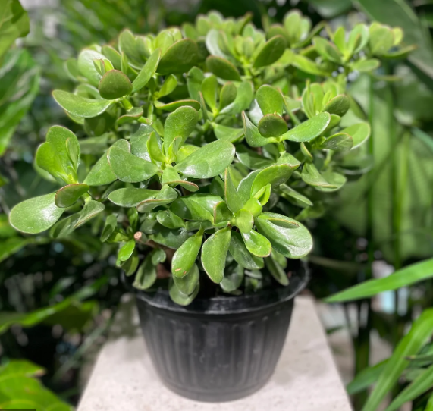
Jade Plant - Crassula ovata
promisesupply.ca
Notes:
Common & botanical name:
CHINESE JADE PLANT-crassula Aborescens (syn. C. cotyledon)
Description:
- Crassulaceae-South Africa origin. Thick turn-like stems & many branches. No pruning necessary.
Size:
Can grow to 4ft /1.2 high & wide
Watering & Air Humidity:
- Water: liberally Spring/Summer. Allow soil to dry between waterings, Apply liquid fertilizer every 2 weeks, Spring to Fall
Light & Temperature:
- Bright light in sunny window, then outdoors in summer to toughen up stems & improve leaf colour Minimum winter temp 45F / 7C, w/ normal room temp other times.
Repotting: if applicable
- Potting Mix w/ some added peat. Move to pots one size up each Spring. At 8"/20 cm pots, top dress annually instead
Pests & Disease:
Mealybugs, scale and spider mites.
Powdery mildew (fungicide or baking soda spray), Anthracnose (dark spots treatable by pruning or copper-based fungicide), Botrytis (grey mould – spray with biofungicide every 2 weeks).
Sooty mold from mealybug honeydew (wash off, treat melybugs)
Black ring virus spread by insects (remove leaves with spots on underside. Treat insect vector).
Propagation:
- Propagate by leaf and stem cuttings, Spring or Summer
Pet Friendly: (i.e. poisonous)
Toxic to dogs and cats.
Mildly toxic to humans (causes vomiting).

Slide 34
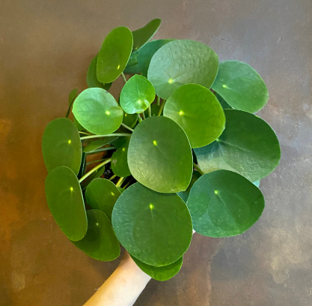
Money Plant - Pilea peperomioides
www.growurbam.uk
Notes:
Common & botanical name:
Money Plant (Pilea peperomioides)
Native range = Yunnan (southern China), in the foothills of the Himalayas.
Description:
Attractive plant for a small space.
Considered lucky because it has good Feng Shui (sheesh)
Round, shiny, bright green leaves
Rarely, small white flowers on pink-tinged stems.
Size:
- 8 to 12 inches tall.
Watering & Air Humidity:
Water when soil dries out (usually once a week). Too much water can kill!
Less water in winter
50% humidity.
Light & Temperature:
Bright indirect light.
Room temperature
Repotting:
- Mix standard potting soil with cactus mix to improve drainage.
- Soil mix = well-draining potting soil using 50% soil, 40% cactus mix and 10% perlite.
Pests & Disease:
Mealy bugs (hand-pick), fungus gnats (reduce watering), spider mites (wash off)
Yellow leaves from overwatering or direct sun.
Leaf curl from direct sun.
Propagation:
Lift and pot up baby plants that are created at the base. Be sure to get the roots!
Baby plants may also grow off of the main stem – cut these off and place in water.
Pet Friendly: (i.e. poisonous)
OK, not poisonous.
Quite delicate, so keep away from active pets.
Fertilizer:
- In spring and summer (growing season), monthly quarter-strength fertilizer application.

Slide 35
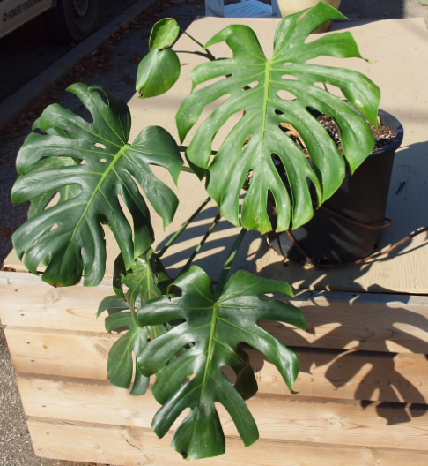
Monstera - Monstera deliciosa
www.nature-and-garden.com
Notes:
Common & botanical name:
- Monstera, Swiss Cheese Plant - Monstera deliciosa
- Origin = Central America
Description:
A twining plant with deeply cut leaves and aerial roots.
Try growing it up a moss or wooden pole.
- A climbing plant in its native habitat, it has very large, deeply lobed leaves and aerial roots.
Deep lobes and slits in leaves help them survive strong winds.
Aerial roots gather moisture from the air.
Tuck the roots into the pot or secure to the pole if you make one.
Size:
8ft after 7 years.
Grow up a moss pole.
Watering & Air Humidity:
Allow to dry out slightly between waterings.
Water less frequently in winter.
Light & Temperature:
Bright indirect light
Room temperature
Repotting:
- Needs a heavy soil mix
- Soil = 2 parts bagged topsoil, 2 parts peat moss and 1 part sand or perlite for drainage
Pests & Disease:
Mealy bugs, spider mites, brown scale.
Brown leaf tips = consistently dry soil.
Small leaves = underfed or insufficient light.
Yellow, falling leaves = uneven watering in summer; natural in winter
Propagation:
Air-layering is best.
Stem-tip cuttings will also work.
Pet Friendly: (i.e. poisonous)
Toxic to pets and humans
Fertilizer:
Feed every 2 weeks in spring and summer with a balanced fertilizer.
Reduce feeding to monthly in winter.

Slide 36
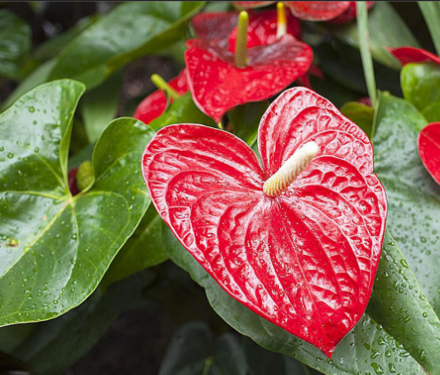
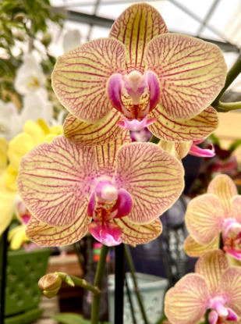
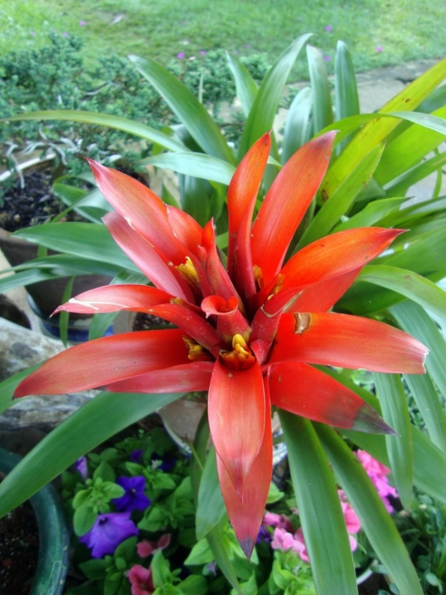
Orchids, Anthuriums, and Bromeliads
https://www.thespruce.com/grow-anthurium-plants-1902738
https://www.jacksonfloristandgardencenter.com/
Notes:
Pics:
Left Orchid= Striped Phalaenopsis cultivar
- Top Right = Flamingo Flower, Anthurium andreanum
- Bottom Right = Bromeliad, Guzmania
Guzmania (Bromeliad) | North Carolina Extension Gardener Plant Toolbox (ncsu.edu)
Details below are for Orchids
Common & botanical name:
- Various
Description:
- Various, but the best Genera for beginners are Cattleya, Dendrobium, Oncidium, Paphiopedilum (lady`s slippers) and Phalaenopsis (Moth orchids)
Size:
- Various
Watering & Air Humidity:
Watering depends on type and where it grows in the wild.
Epiphytic (tree-dwelling) types need to dry out between waterings.
Terrestrial orchids (Lady`s slippers) need steady moisture.
When in doubt keep things on the dry side. Too much water will rot roots.
Healthy roots have green tips. It`s OK if they come out of the pot.
Flush accumulating salts out with a heavy, repeated watering every month during the summer.
Humidity = 50%
Light & Temperature:
Bright, indirect light. Lady`s slippers and moth orchids do not need as much.
Temperature = a difference of 15 to 20F between day and night temperatures. This is vital for reliable flowering.
- They benefit from being outside in the summer, but slugs love the soft flower buds
- There are 3 categories of temperature preferences (warm, intermediate, cool) – do your research.
Repotting:
Soil = Orchid mix is usually bark chips with small amounts of peat, perlite or vermiculite.
This mix decays over about 2 years, which is the repotting interval (when actively growing)
Flowering is better if the pot is crowded.
Repotting is slightly different for monopodial (upright = lady`s slippers and moth) versus sympodial (the other 3 types listed) orchids. Discard all of the old potting mix.
Sympodial orchids have a creeping rhizome. Discard the oldest pseudobulb and repot the plant off-centre to give it room to grow.
Pests & Disease:
No bloom = insufficient temperature gradient. Also too much food or not enough light.
Leaf tips brown = too much food, improper watering.
Light green leaves = too much sun.
Leaves crinkled and blotched, with slow growth = virus. Destroy the plant and disinfect tools to avoid spreading the disease.
Mealybugs, slugs (outdoors)
Flowers have small brown spots = petal blight fungus. Remove affected blooms and increase air circulation.
Propagation:
Cattleya and Oncidium will produce pseudobulbs that increase over time. They can be planted in groups of 3.
Lady`s slippers form clumps which can be divided every few years.
Dendrobiums produce aerial roots. Cut off the stem below the roots and plant it.
Dendrobiums and Moth orchids produce Keikis (plantlets) with small roots on the stem. Remove these and plant.
Plant in a 4 inch pot so the root system grows into a compact ball.
Mist new plants for a few weeks for high humidity.
Pet Friendly: (i.e. poisonous)
- Not toxic
Fertilizer:
High N food given at one quarter normal strength on a weekly basis.
High P food when flower buds start to show.
If the plant sheds its leaves and rests in winter do not feed it.
Anthuriums
Common & botanical name:
Anthurium andreanum – Flamingo Lily, the most commonly available species.
Native to Ecuador and southwest Colombia.
There are many types of “velvet-leaf” Anthuriums that are starting to become more available to the more enthusiastic and discerning indoor gardener. Some of these are very large.
Description:
Leaves are bright green and heart-shaped.
Flowers are small and concentrated in a spadix (about 8 cm long) that rises above a bright red spathe (8 to 15cm long).
There are plenty of variations of A. andreanum, with a different coloured spathe (pink, white).
The fruit is a fleshy berry.
Size:
12 to 18 inches tall; 9 to 12 inches wide.
Watering & Air Humidity:
Native environment = tropical rainforest (warm, shady, humid).
Keep potting medium moist but not wet.
Use a pebble tray filled with water to raise humidity around the plant.
Mist regularly or use a humidifier during winter months for best results.
Light & Temperature:
– Bright. Indirect light.
- Being a tropical rainforest plant typical indoor temperature (>60F) is good.
Repotting: if applicable
Use potting mix tailored for orchids, with a few handfuls of sand and a few handfuls of peat moss mixed in.
Repot every 2 years into a slightly larger pot.
The new pot should be deeper so that air roots can be covered with more medium as they appear.
Pests & Disease:
Brown scale, mealybugs, whitefly, spider mites and aphids.
Use insecticidal soap or horticultural oil, along with strong squirts of water.
- Most common diseases are root rot (good drainage), bacterial blight (no overhead watering) and powdery mildew (sulphur spray).
Propagation:
Propagate when air roots start to stick out from the stems.
Cut off an air root, or 6 inches of a stem with 2 or 3 sets of leaves, and plant in new potting medium (keep moist).
Using rooting hormone can improve results.
Pet Friendly: (i.e. poisonous)
Anthurium plants contain saponins, and are poisonous due to calcium oxalate crystals in fine needles which can penetrate mucous membranes (e.g. the mouth) and cause severe irritation.
The sap is also irritating to the skin and eyes.
Fertilizer:
- Use a fertilizer high in P, dilute to ¼ strength and apply weekly (so weakly, weekly).
Bromeliads
Common & botanical name:
Various.
Pic = Guzmania lingulata (Scarlet Star).
Description:
Guzmania lingulata and many other types of Bromeliad are epiphytic (e.g. The “air plants” sold in nurseries). Most are native to Mexico, Central America and north-western South America.
G lingulata does well when tied to a large piece of bark, with roots anchored in a loose potting mixture.
This has small white flowers above showy red bracts. Flowers may last as long as 4 months.
Other bromeliads are terrestrial, meaning they are normally rooted in soil – example = pineapple.
Size:
Various depending on genus/species.
Guzmania lingulata = 1 to 2ft tall and same spread.
Watering & Air Humidity:
G. lingulata = allow medium to dry out between watering.
High humidity is also needed.
Light & Temperature:
Various depending on genus/species.
G. lingulata = bright, indirect light and min temperature of 60F at night.
Repotting: if applicable
Repot if potting medium becomes too heavy (air needs to reach the roots)
Note: After flowering the plant dies.
Pests & Disease:
Root rot if overwatering (or medium mix is too moisture-retentive).
Scale, spider mites and mealybugs.
Propagation:
Mother plant dies after flowering, but offsets can be planted.
Pet Friendly: (i.e. poisonous)
G lingulata and other bromeliads are not toxic.
Fertilizer:
- Dilute fertilizer by 50%.

Slide 37
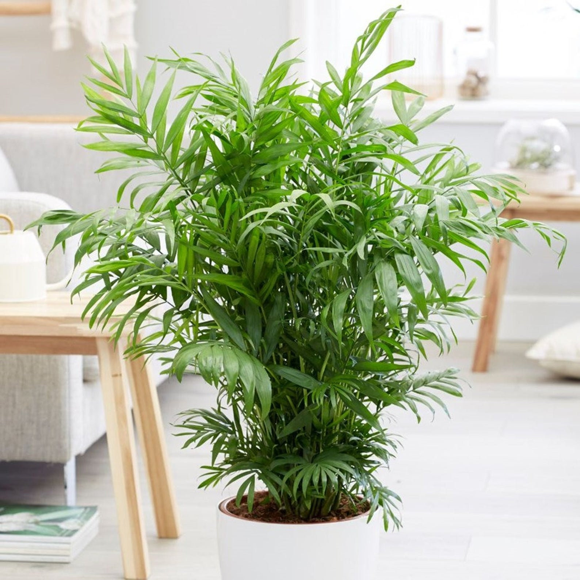
Parlour Palm - Chamaedorea elegans
Notes:
Common & botanical name:
- Parlour Palm - Chamaedorea elegans
Description:
A mature size has tiny yellow flowers and small fruit if grown in good light
Size:
- Purchased at 6-12 inches, adult height after 2 years is 2 feet
Watering & Air Humidity:
Good drainage is required, do not like stagnant water at the roots
During winter keep the soil slightly most
Water more liberally in spring and summer
Mist leaves if room is heated, occasionally sponge mature leaves, avoid droughts
Light & Temperature:
Keep in partial shade, can thrive in low light
Average warmth, minimum 50F in winter, not to exceed 60F
Repotting:
- Only repot when the plant is pot bound , palms dislike disturbances
Pests & Disease:
Insects: scale, spider mite, and mealy bug
Disease: Brown spots
Propagation:
- From seed
Pet Friendly: (i.e. poisonous)
- Non-toxic for pets and humans.

Slide 38
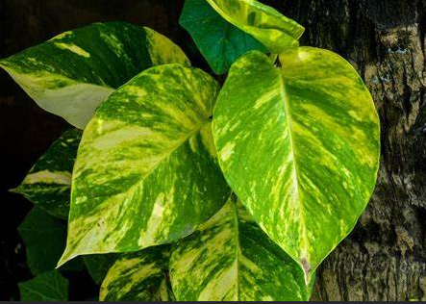
Pothos - Epipremnum aureum
https://en.wikipedia.org/wiki/Epipremnum_aureum
Notes:
Common & botanical name:
- Epipremnum aureum (formerly Pothos aureus). Still commonly called Pothos.
Origin = Society Islands (French Polynesia)
Description:
- An attractive vining plant with bright, waxy, heart-shaped and variegated leaves that very rarely flowers.
Size:
This will keep vining for 40ft or more if allowed.
Pinch off tips to keep to desired length.
Watering & Air Humidity:
Water more during periods of active growth (Dec through May), and less at other times.
High humidity (50%+) is best. Dry air will cause leaf tips to turn brown.
Light & Temperature:
Bright indirect light.
OK in normal room temperatures (70F is ideal).
Repotting:
Use a peaty potting mix.
Repot in spring (into a slightly larger pot) and make sure medium is free-draining.
Pests & Disease:
Root rot in poorly-drained soils.
Fungal leaf spot and botrytis
Scale, mealybugs and spider mites.
Propagation:
Stem cuttings can be placed into water or potting medium.
Vines can also be weighted with a pebble to hold aerial root nodules to potting medium until they grow.
Pet Friendly: (i.e. poisonous)
- Toxic (calcium oxalate crystals).
Fertilizer:
general all-purpose fertilizer every 2 or 3 months Dec through May.

Slide 39
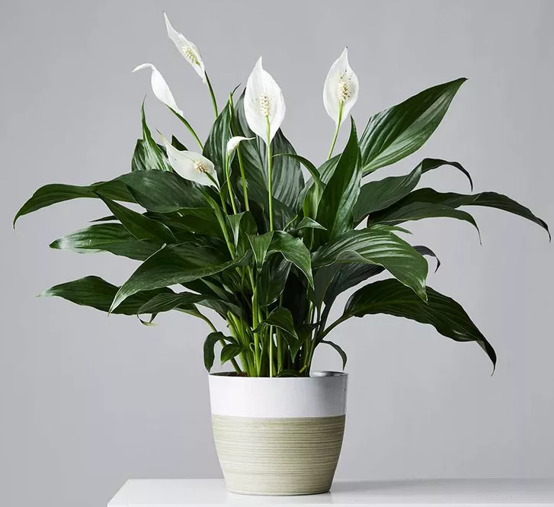
Peace Lily - Spathiphyllum wallisii
www.mydomaine.com
Notes:
Common & botanical name:
PEACE LILY - Spathiphyllum wallisii- South America origin
Description:
- Arumlike white flowers on stiff stems 18" /46 cm, dark green strongly veined lance shaped leaves
Size:
Usually up to 3ft in an indoor setting.
Watering & Air Humidity:
- high humidity replace on bed of gravel to help prevent infestation. Keep soil moist in growing season, allow soil to dry between waterings, mist daily in Summer.
Light & Temperature:
Bright light, no direct sun, 60-70 degrees F / 16-21 deg C
Repotting:
- Peat Moss based soil.
Pests & Disease:
- In hot/dry conditions, red spider mite often attack plant. Increase misting & set plant on dish of moist gravel to raise humidity & help prevent infestation of red spider mites.
- Feed w/ balanced liquid fertilizer every 2 weeks, Spring & Summer
Propagation:
- Divide in Spring- pull apart rhizomes & re-pot to one size larger pot
Pet Friendly: (i.e. poisonous)
Toxic to dogs and cats.
A potential irritant to humans. It can cause a burning sensation in the mouth if eaten (why do this?) and contact dermatitis.

Slide 40
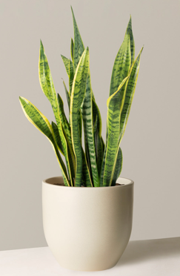
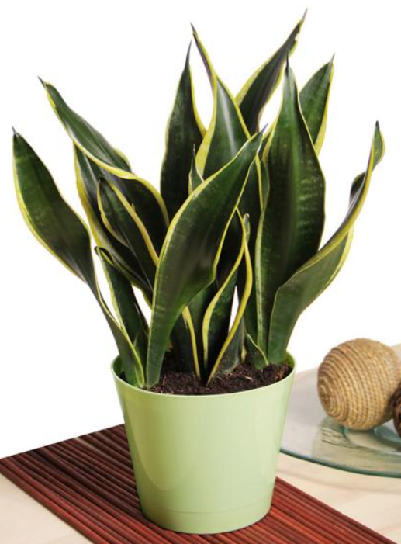
Snake Plant - Dracaena trifasciata
www.thesill.com
www.hgtv.com
Notes:
Common & botanical name:
Snake Plant - Dracaena trifasciata
Tropical west Africa (Nigeria to Congo)
Description:
- The Shake Plant is one of the easiest plants to grow indoors
- If you prefer decorative planters, consider housing your snake plant in a plastic container with drainage holes that can fit comfortably into a more ornamental container—removing the center pot when watering and allowing it to fully drain before moving back to the larger container—to ensure the soil stays dry.
Size:
Up to 8ft tall!
The clump will gradually get wider if you allow it more space (by repotting into a larger container).
Watering & Air Humidity:
Snake plants are very drought tolerant, so underwatering is rare. But overwatering is a quick route to root rot.
During the active summer growing season, water only when the soil feels dry about 3 inches deep.
Then water thoroughly.
During winter, water only as needed to keep leaves looking and feeling firm.
Light & Temperature:
– Snake plants are versatile but avoid light extremes for best results. They tolerate poor light and prolonged shade, but they prefer strong, filtered light. Warm, sunny locations protected from direct hot sun are ideal
- Snake plants prefer warm conditions. Set the plant in a place where it will be protected from drafts. In the winter, protect the plant from drafty windows.
Repotting: if applicable
- Because Snake Plants do not tolerate oversaturated soils, a container with good drainage is crucial. The soil should also be well-draining.
Pests & Disease:
- Very few
Propagation:
- Division.
Pet Friendly: (i.e. poisonous)
Toxic to dogs (contains saponins).
Generally too tough for cats to be interested in.
Fertilizer:
- Not really needed, but weak fertilizer application every couple of weeks in spring and summer will not hurt.

Slide 41
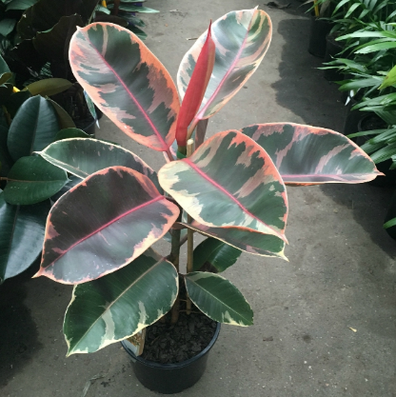
Rubber Plant - Ficus elastica
www.nurseryserve.com
Notes:
Common & botanical name:
- Rubber Plant - Ficus elastica
- Origin = South and southeast Asia
Description:
Tall plant with large, glossy leaves.
Many variegated cultivars available. Pic = Ficus elastica `Tricolour`
A large plant that makes a handsome specimen.
Many attractive cultivars
Size:
- 40ft tall in the wild, but years to reach 12ft indoors. Can be used in a large pot as a floor specimen when it becomes large.
Watering & Air Humidity:
Moist but not wet in spring and summer.
Allow soil to dry out slightly in winter.
Light & Temperature:
Bright indirect light
Room temperature.
Repotting:
Average potting mix is fine
Repot every 2 years.
Do not repot if the plant is shedding leaves (it pays to keep the environment stable for awhile)
Pests & Disease:
Spider mites
Large, dark leaves and little new growth = insufficient light.
Leaf-drop due to environmental changes (allow 6 weeks to stabilize)
Wash leaves when they become dusty
Propagation:
Air-layering when they get too big.
Nick the stem just below where a leaf detached to stimulate new growth (branching)
Aerial roots can be tucked into the pot.
Pet Friendly: (i.e. poisonous)
May be toxic to dogs and cats.
Sap can be an irritant (will cause a reaction).
Fertilizer:
3 or 4 times a year give it a balanced fertilizer with micronutrients
Twice a year add half a teaspoon (2.5ml) of Epsom Salts to a quart of water and soak the roots.

Slide 42
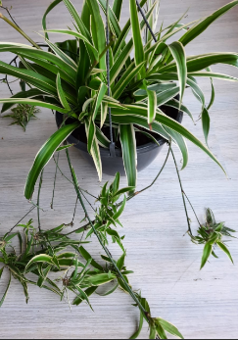
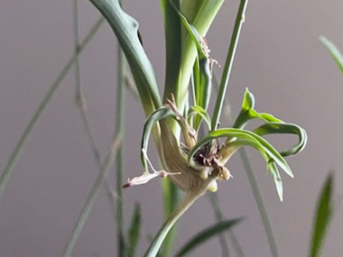
Spider Plant - Chlorophytum comosum
www.ediblewildfood.com
www.clicknplant.co.za
Notes:
Common & botanical name:
Spider Plant - Chlororphytum comosum
Origin = South African coastal areas.
Description:
Easy to care for apart from being sensitive to contaminants (like Fluoride) in city tap water.
Small and compact, arching leaves ...good for hanging baskets, especially when the plantlets are borne on long stems
This can also be placed on a table so the plantlets can hang down.
The species has long (to 15”) green straplike leaves. The ‘Vittatum’ (white stripe down the middle of the leaf) form is the most commonly grown variety. The pic is the variegated form.
Small white flowers on long, arching stems are followed by plantlets.
Size:
- Happy in a 6” pot
Watering & Air Humidity:
Keep soil moist in summer, drier in the winter.
Spray (mist) occasionally during the winter.
Keep moist in spring/summer, drier in winter.
Thick rhizomes store water.
Light & Temperature:
Bright indirect light (lives on cliffs and forest floor in native land)
Does not like hot temperatures (> 90F).
Repotting: if applicable
Soil = standard potting medium works well
Repot young plants annually in spring. Mature plants every two years.
Pests & Disease:
Brown scale
Brown leaf tips are the result of fluoride and chlorine in tap water (also low humidity and excessive dry soil). Use filtered or distilled water.
Propagation:
Place outdoors in a shady location during the summer. It will produce plantlets when the days start getting shorter.
Alternately put it in a room that is not used during the evening and night so it will experience the shortening days.
Don’t let the plantlets get too old...smaller and medium-sized babies root best.
Pet Friendly: (i.e. poisonous)
OK, not toxic
Fertilizer:
In spring and summer, every 2 weeks with 50% diluted fertilizer solution.
In autumn, same dose every month
Note – too much fertilizer reduces plantlet production.

Slide 43
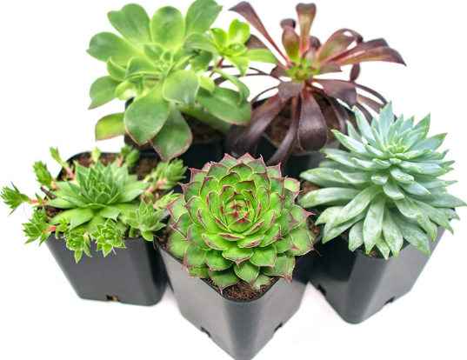
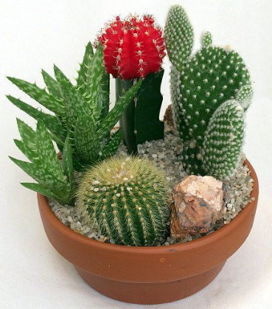
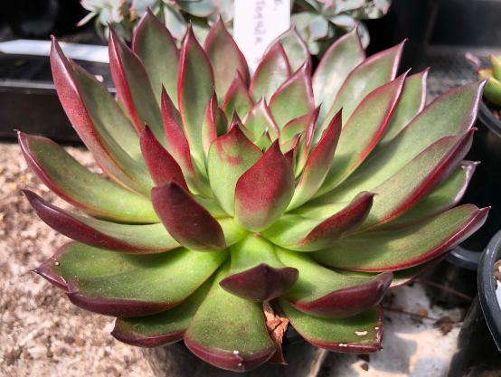
Succulents, Cacti
Walmart.com
Pinterest.com
www.succulents-australia-sales.com
Notes:
Pics:
Left = various cacti
Top right = various succulents
Bottom right = Echeveria agavoides `Rubra`
Common & botanical name:
Various
Origin: Cacti = western hemisphere; Succulents = most began in Africa, Asia, Europe and Oz.
Description:
- Various
Size:
- Various
Watering & Air Humidity:
Much less water in winter (roots will rot)
Minor shrivelling of tissues is no cause for panic – a couple of doses of water should rehydrate the plants.
Summer = more water.
Cacti = frequent shallow watering rather than soaking
Succulents need twice as much water as cacti.
Don`t let water collect in succulent rosettes too often.
- Low humidity, but watch for spider mites – mist them regularly
Light & Temperature:
Lots of light, so they can go outside in the summer.
BUT!! Leaves that have grown to cope with indoor light levels will be sunburnt, so they need to start in the shade and be moved gradually into the sun.
Once acclimated, a few hours of direct sun is fine.
Move them back inside slowly in the autumn.
Temperature = cooler in winter if possible (below 60F at night).
This may be required for some species in order to set flower buds.
Repotting: if applicable
Soil = cactus mix or regular mix with added sharp sand (large-grained sand) or perlite for drainage.
Use 1 part sand or perlite to 2 parts potting medium.
a layer of pebbles in the bottom of the pot adds weight and drainage.
Repotting = repot when the plant clump reaches to within half an inch of the edge of the pot...or when it is pot bound
Upright, tall plants should be in deep pots. Low plants with shallow roots (Agave) can be in wide, shallow pots.
Be careful with cacti. Wrap the plant with strips of newspaper, held by one hand. Wear gloves!
Be careful with succulents, as the leaves are usually very delicate.
Pests & Disease:
Root rot due to overwatering
Brown or grey patches due to sunburn
Crooked growth due to too little light, maybe combined with too much feeding.
Spider mites, mealybugs, scale insect, aphids on succulents
Propagation:
Propagate in late spring or early summer (actively growing)
Cacti = sever an offset or a pad with a sharp knife, let the wound callus (harden) for a day or two, then plant. Give it time.
Succulents usually form offsets or plantlets, sometimes stem cuttings. Again, let the cutting callus for a day or two.
Pet Friendly: (i.e. poisonous)
Spines on cactus are to be avoided.
Fertilizer:
Slow-growing, so a lower level of nutrients (especially N) is required.
Use a High P and Low N product at 50% strength.

Slide 44
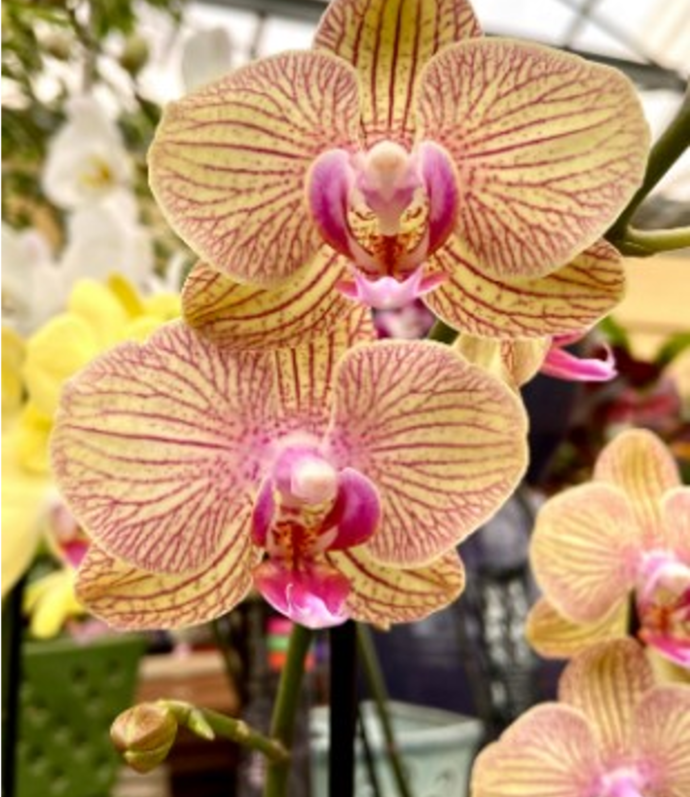
Wrap Up

Slide 45
References
Etobicoke Master Gardeners www.etobicokemastergardenres.ca
Master Gardeners of Ontario www.mgoi.ca
The House Plant Expert, Dr. D.G. Hessayon
Making Things Grow – A Practical Guide for the Indoor Gardener, Thalasso Cruso, Alfred A. Knopf, New York, 1973
laidbackgardener.blog ( late Larry Hodgson)
gardenmyths.com (Robert Pavlis)
University of Minnesota Extension
extension.umn.edu/find-plants/houseplants
North Carolina Extension Gardener Plant Toolbox
plants.ces.ncsu.edu/plants/monstera-deliciosa/
plantophiles.com/category/plants/
.aspca.org/pet-care/animal-poison-control/toxic-and-non-toxic-plants

Slide 46
You can find a copy of the presentation EMG Website > Community Activities > Resources

Slide 47
Etobicoke Master Gardeners
Thank you!
Questions
Notes:
-

